Slide 1

Project Presentation

Slide 2

The Problem:
How many times did you buy a clothing item online, got really exited and then got super disappointed when it arrived, and it didn't fit as well as you imagined?
Unfortunately - While buying clothes online, it is difficult for a customer to select a desirable outfit in the first attempt because they can’t try on clothes before they are delivered physically.

Slide 3

The Solution:
E-commerce websites can be equipped with virtual dressing rooms that allow users to try on multiple clothes virtually and select the best-looking outfit.
It's never been easier to look fabulous!!!

Slide 4

The Approach:
I created a Virtual clothing assistant using Deep learning algorithms in order to help the consumers.
The user can select the clothing item he/she wants to wear and then upload his/her image of any pose they want, and the assistant will help to dress that human with his/her selected clothing item.

Slide 5

So how exactly does it work?

Slide 6
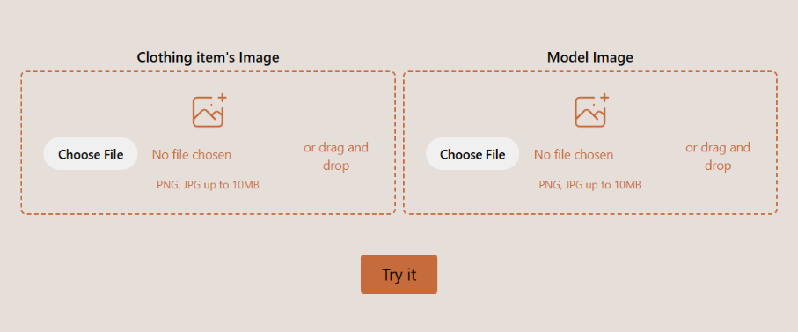
Input
We allow the user to upload his/her image and their clothing item’s image.

Slide 7
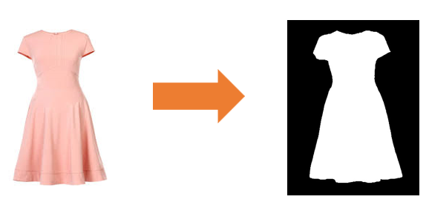
Cloth mask
We create a cloth mask with U2Net.

Slide 8
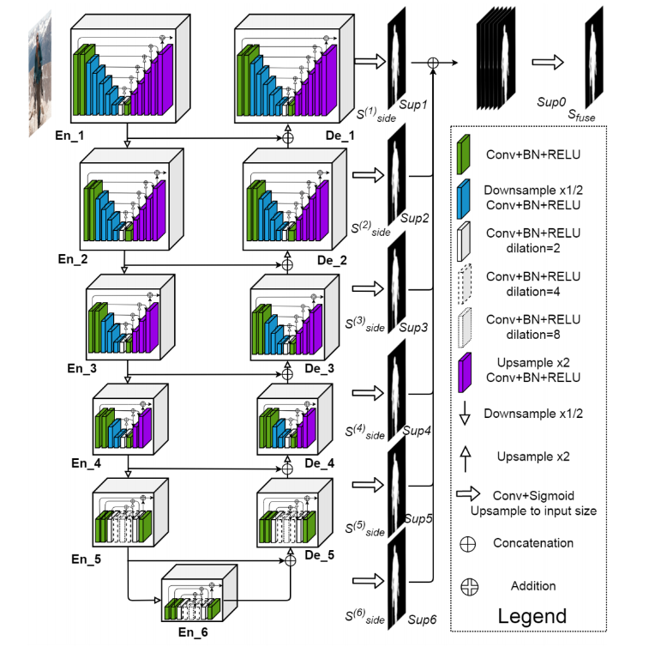
What is U2Net?
U2Net is a deep neural network architecture for image segmentation tasks, based on a U-shaped encoder-decoder network structure with nested U-shaped blocks. It uses a "salient object sub-network" with attention mechanisms to highlight important regions in the image and has achieved state-of-the-art results in various benchmark datasets for salient object detection and other image segmentation tasks.
U2Net was proposed in a paper titled "U2-Net: Going Deeper with Nested U-Structure for Salient Object Detection" by Qin et al. in 2020.
You can see the implementation of U2Net in model/u2net.py file in the project.
Notes:
Salient object sub-network is a deep learning model that identifies visually distinctive regions of an image.

Slide 9
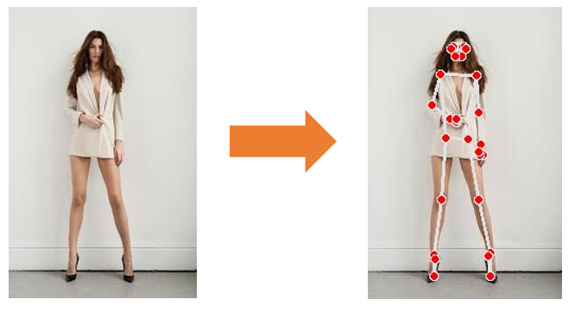
Body position
We get a body position estimation and key points with Mediapipe.

Slide 10
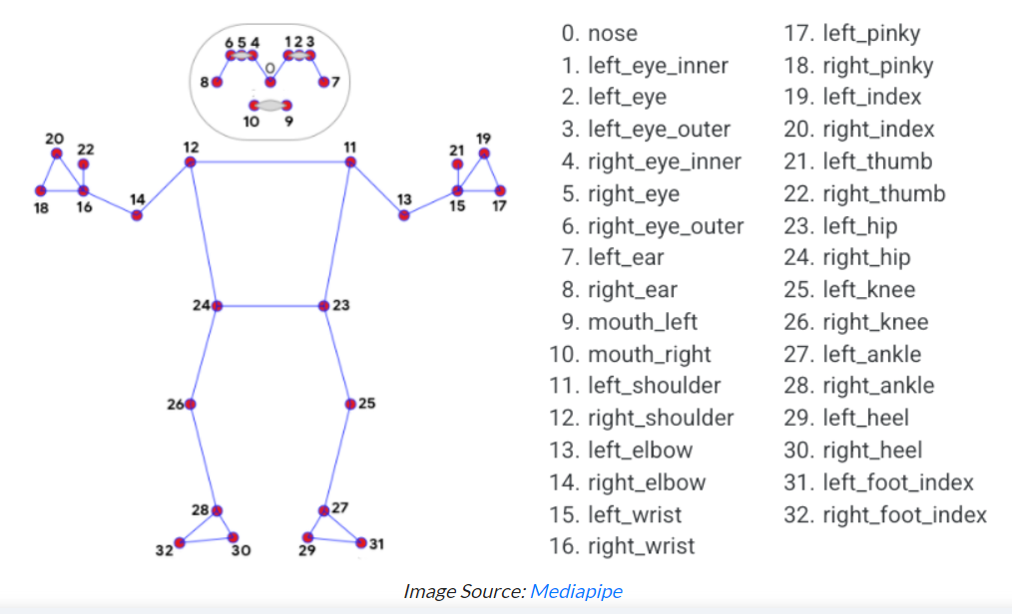
What is Mediapipe?
Mediapipe is a versatile framework developed by Google
that provides tools for building various computer vision and machine learning applications, including pose estimation.
My code uses the Mediapipe library to perform pose estimation on the model image, saves the detected pose landmarks, and creates an annotated image for
visualization.
Notes:
Link for Mediapipe: https://developers.google.com/mediapipe/solutions
Farther explanation: https://www.assemblyai.com/blog/mediapipe-for-dummies/

Slide 11
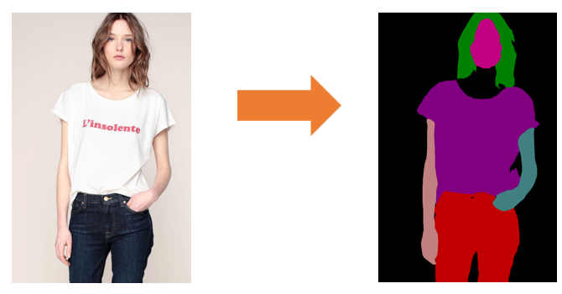
Body Parsing
We parse the user body with Self-Correction-Human-Parsing

Slide 12
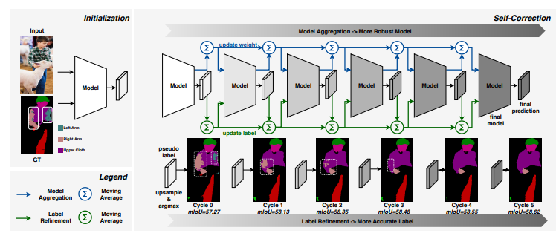
Self-Correction-Human-Parsing
A parsing of human body parts or clothing
in images using a deep neural network.
It provides flexibility in choosing the
dataset, specifying input and output
directories, and optionally saving logits for
further analysis.
Notes:
Link for Self-Correction-Human-Parsing:
https://github.com/GoGoDuck912/Self-Correction-Human-Parsing

Slide 13
Body Segmentation
Network [SegGenerator] was created. Total number of parameters: 34.5 million. To see the architecture, print(network). SegGenerator( (conv1): Sequential( (0): Conv2d(21, 64, kernel_size=(3, 3), stride=(1, 1), padding=(1, 1)) (1): InstanceNorm2d(64, eps=1e-05, momentum=0.1, affine=False, track_running_stats=False) (2): ReLU() (3): Conv2d(64, 64, kernel_size=(3, 3), stride=(1, 1), padding=(1, 1)) (4): InstanceNorm2d(64, eps=1e-05, momentum=0.1, affine=False, track_running_stats=False) (5): ReLU() ) (conv2): Sequential( (0): Conv2d(64, 128, kernel_size=(3, 3), stride=(1, 1), padding=(1, 1)) (1): InstanceNorm2d(128, eps=1e-05, momentum=0.1, affine=False, track_running_stats=False) (2): ReLU() (3): Conv2d(128, 128, kernel_size=(3, 3), stride=(1, 1), padding=(1, 1)) (4): InstanceNorm2d(128, eps=1e-05, momentum=0.1, affine=False, track_running_stats=False) (5): ReLU() ) (conv3): Sequential( (0): Conv2d(128, 256, kernel_size=(3, 3), stride=(1, 1), padding=(1, 1)) (1): InstanceNorm2d(256, eps=1e-05, momentum=0.1, affine=False, track_running_stats=False) (2): ReLU() (3): Conv2d(256, 256, kernel_size=(3, 3), stride=(1, 1), padding=(1, 1)) (4): InstanceNorm2d(256, eps=1e-05, momentum=0.1, affine=False, track_running_stats=False) (5): ReLU() ) (conv4): Sequential( (0): Conv2d(256, 512, kernel_size=(3, 3), stride=(1, 1), padding=(1, 1)) (1): InstanceNorm2d(512, eps=1e-05, momentum=0.1, affine=False, track_running_stats=False) (2): ReLU() (3): Conv2d(512, 512, kernel_size=(3, 3), stride=(1, 1), padding=(1, 1)) (4): InstanceNorm2d(512, eps=1e-05, momentum=0.1, affine=False, track_running_stats=False) (5): ReLU()
We segment the user body with SegGenerator.

Slide 14
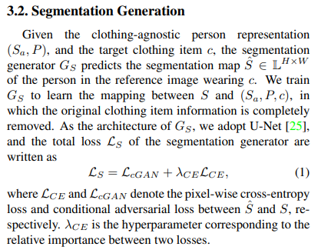
SegGenerator
Semantic segmentation pipeline designed for human parsing. Its primary function is to process input data and produce a detailed segmentation map that identifies various human body parts and clothing items.
from the paper: "VITON-HD: High-Resolution Virtual Try-On via Misalignment-Aware Normalization" by Choi,Park,Lee and Choo in 2021.
Notes:
"VITON-HD: High-Resolution Virtual Try-On via Misalignment-Aware Normalization" by Choi,Park,Lee and Choo in 2021.
https://arxiv.org/pdf/2103.16874.pdf

Slide 15
Generating the result
These are used to create a new image of the user wearing the requested cloth item. The image is created using ALIASGenerator.

Slide 16
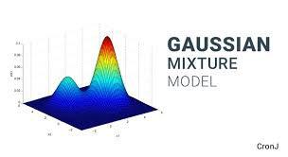
What is ALIASGenerator?
the ALIASGenerator is a component of the GMM network* used for image generation, specifically for generating a latent code for the appearance of the clothes. It uses an adaptation of the Alias Method to sample from a Gaussian mixture distribution, allowing it to generate diverse and realistic appearance codes for the virtual try-on image.
You can see the implementation of the generator in model/network.py file in the project.
*GMM (Gaussian Mixture Model) is a type of generative model that is commonly used for image and data generation tasks. A GMM network consists of several Gaussian distributions that are combined to model the distribution of the data.
Notes:
The ALIAS method is a technique used to generate random variables with specified probability distributions. It works by constructing two arrays, one of probabilities and another of alias values, and comparing a randomly generated integer to the probabilities array to select an outcome. It is a simple and efficient method commonly used in computer simulations.

Slide 17
The Result

